Slide 1
Application Design

Slide 2
Engineering A Real Application
Architecture Considerations

Slide 3
Agenda
01
Introducing “Your Events”
02
Cloud architecture solution

Slide 4
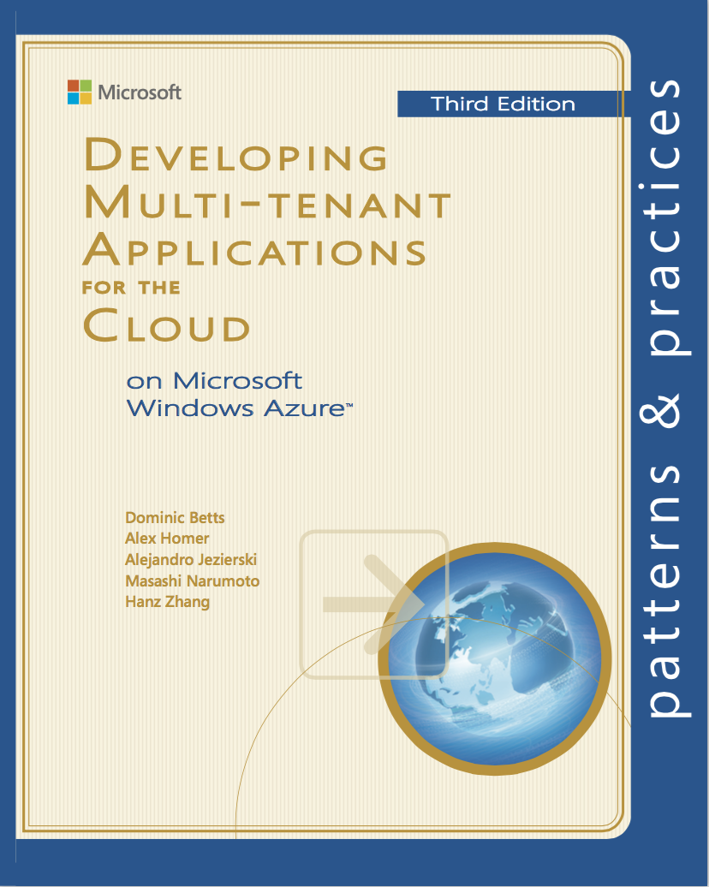
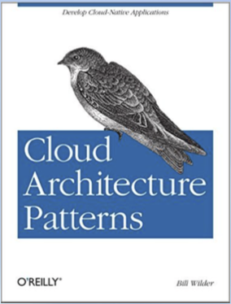
Introduction
REFERENCES
Some useful readings
The topics covered in this lecture have been partially adapted by some of the best practices and patterns discussed in the following titles:
Developing Multi-Tenant Applications for the Cloud, 3rd Ed.
Dominics Betts, Alex Homer, Alejandro Jezierski, Masashi Narumoto, Henz Zhang
Microsoft Pattern and Practices Series
ISBN: 978-1-62114-023-8
Cloud Architecture Patterns
Bill Wilder
(O’Reilly) ISBN: 978-1-449-31977-9

Slide 5
Introduction
DISCLAIMERS
This is an example!
PURPOSE
The scenario discussed in this lecture depicts a “realistic” cloud application that is used as a mean to explore key aspects of cloud application development. To facilitate the discussion and focus on the final purpose of the lecture, some of the complexity of a “real production” application has been removed.
CHOICE OF SCENARIO
As per the above, even the choice of scenario has been driven by defining a reference application that would help illustrate solutions and approaches to cloud application development. By no means there is the intention that specific type of application chosen is “the missing product”.
WHERE TO GO FROM HERE
The content provided in this lecture should be considered by no means a complete treatment of the cloud application engineering, rather a start to further explore the topics discussed and the solutions proposed.

Slide 6
Introducing “Your Events”
This is the case study that we will use for the next lectures

Slide 7
Introducing “Your Events”
BACKGROUND INFORMATION
Meet Cloud Dynamics
STARTUP PROFILE
Cloud Dynamics is a newly formed startup that leverages cloud computing technologies. The company is a mixture of young and technically skilled developers, UI/UX experts, and agile consultant that engage with small / medium organisation to solve their business challenges.
HISTORY
Until now, Cloud Dynamics has primarily acted as a consulting company. They met the client, discussed the challenges, and worked with the client’s IT staff to provide a technical solution by leveraging the latest cloud computing technologies.
After a year of operations and having worked with several organisations, Cloud Dynamics identifies several opportunities to position itself in the market with one (or more) key product that could attract either prior or new customers.

Slide 8
Introducing “Your Events”
BACKGROUND INFORMATION
Cloud Dynamics’ new application
SELECTING THE OPPORTUNITY
“YOUR EVENTS” – CLOUD BASED EVENT MANAGEMENT
After reviewing the different options Cloud Dynamics decides to design and develop a solution for online event management, which, after a brief market research, seems to be the idea with highest chances of success. They decided to call it “Your Events”.
IDENTIFYING THE NEED
KEY FEATURES OF “YOUR EVENTS”
The application would allow any subscribed organisation to publish events (parties, celebrations, recognition events) and provide means for the organisation’s employee to join the events and post comments.
These were the most recurring demands that Cloud Dynamics identified by talking with their own customers.

Slide 9
Introducing “Your Events”
BACKGROUND INFORMATION
Cloud Dynamics’ new application
BUSINESS DRIVER
A DESIRED BUT NOT A “CORE BUSINESS” FUNCTION
Organising internal events is not a core business function of many organisations. Therefore, the IT support for this need is often not met within the organisation itself. Still, there is demand for this capability, which, because of its sporadic nature, organisation may prefer to “lease” rather than investing in its implementation.
THE SaaS SOLUTION
ONLINE EVENT MANAGEMENT AS SaaS OFFERING
Cloud Dynamics believes that offering online event management through subscription / pay per use is a great opportunity to establish itself and capture this growing market.
By providing a SaaS application, Cloud Dynamics could leverage economies of scale and ammortise costs by spreading them across multiple customers and eventually generate profit.

Slide 10


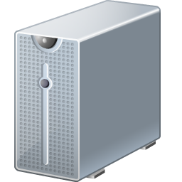


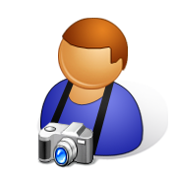

Introducing “Your Events”
YOUR EVENTS
A 10000 foot view
Here is, at a glance, how the application will work:
Dream Cruises
Management
1
Employees
Dream Cruises Space
2
Team Voices
YOUR EVENTS
(WEB UI)
1
Create event (manage)
Management
1
2
RSVP
Comment
Upload photo
Team Voices Space
Employees
Cloud Dynamics
2

Slide 11



Introducing “Your Events”
YOUR EVENTS
Features and personas, quick overview
As initial release (MVP) the application will provide basic functionalities for event management, for a “customer organisation”.
The application identifies 3 basic roles:
CLOUD DYNAMICS STAFF
Cloud Dynamics staff are “super users”: they manage the subscriptions, administer the applications (e.g. updates, bug fixes, monitoring) and have a 360 degrees view of the application.
ORGANISATION MANAGERS
Organisation managers, are administrative users within the organisation’s allocated space. They create events and moderate content posted by employee.
ORGANISATION EMPLOYEES
Organisation employees, have access to the organisation’s allocated space and they can RSVP events, post comments and photos on events.

Slide 12
Introducing “Your Events”
YOUR EVENTS
Expectations: customer’s perspective
Willing to pay for the service, the customer has the following requirements:
01
ISOLATION
Each organisation perceives the application as its own, and does not want to be affected by the activities of the other organisations, neither wants its data to be exposed to other organisation.
02
AVAILABILITY
Despite event management is not a core business function, the web application is expected to be always available or have its availability defined by a SLA.
03
SCALABILITY
Individual organisations will expect the application to scale as the demand grows despite other organisations are using the same application.

Slide 13
Introducing “Your Events”
YOUR EVENTS
Expectations: customer’s perspective
(…continued)
04
COSTS
Each organisation would expect to pay a lower cost compared to the one paid for an “on premises” solution or a dedicated web application. This is the one of the adtantages of a SaaS offering.
05
CUSTOMISABILITY
Customers might want to be able to customise the application in terms of brand logo, style sheets. Additional customisation impling custom data format and custom plugins need to be carefully assessed.
06
REGULATORY COMPLIANCE
In this case, because of the nature of the application there is no specific requirements for compliance, as the information maintained is not sensitive. Still, some level of security is expected.

Slide 14
Introducing “Your Events”
YOUR EVENTS
Expectations: provider’s perspective
The key goals of the provider are to provide a good service and generate profit while doing it. Therefore, the following requirements:
01
MEET CUSTOMER’S (AGREED) EXPECTATIONS
Cloud Dynamics primary concern is to ensure that the SaaS offering meets the customer expectations, which have been defined through the SLA (availability, data confidentiality, performance, …).
02
PROFITABILITY
Cloud Dynamics is providing “Your Events” as a commercial offering. Hence, the need to run the service with a profitable margin, which ensure its future delivery and prosperity.
03
BILLING
Cloud Dynamics requires a way to bill the different customers. In order to provide a fair billing, the application needs to be instrumented with monitoring capability that will inform the costing scheme.

Slide 15
Introducing “Your Events”
YOUR EVENTS
Expectations: provider’s perspective
(…continued)
04
DIFFERENT SERVICE LEVELS
Even though not planned for the initial release, Cloud Dynamics expects to differentiate the service in order to attract a larger market segment. This has implications on the application architecture and design.
05
PROVISIONING
Because each customer expects to have its own environment, the provider needs to put in place a mechanism for providing new environments for new customer. It is better is such process is automated.
06
MAINTAINABILITY
As the user base grows and the application takes up the market, Cloud Dynamics needs to be able to easily upgrade, bug fix, and maintain the application, with minimal impact on existing customers.

Slide 16
Introducing “Your Events”
YOUR EVENTS
Expectations: provider’s perspective
(…continued)
07
MONITORING
Monitoring is not only required to identify problematic trends that would prevents meeting the agreed SLA but it is also required to capture the activities of the customers to inform billing and learn about usage.
08
AUTOMATION
As the number of customers grows manual processes become unsustainable for Cloud Dynamics and a large number of tasks need to be automated from deployment, to elastic scalability, and other functions.

Slide 17
Introducing “Your Events”
THOUGHTS
How to design and implement “Your Events”?
When analysed with a bit of detail, “Your Events” already shows a considerable degree of complexity.
Such complexity is primarily due to delivering “Your Events” as SaaS offering, and to what this entails from both the customer’s and provider’s perspective.
We will explore how to build such applications by looking at:
01
CLOUD SOLUTION ARCHITECTURE
02
SCALABILITY AND AVAILABILITY
03
SECURITY
04
CUSTOMISATION

Slide 18
Solution Architecture

Slide 19
Cloud solution architecture
CLOUD OFFERINGS
IaaS, PaaS, or SaaS?
Cloud Dynamics has decided to leverage cloud computing technology to deliver “Your Events”. What is the right approach?
APPLICATION CONSUMPTION AND CONFIGURATION
APPLICATION CONSUMPTION AND CONFIGURATION
EFFORT CONTROL
APPLICATION CONSUMPTION AND CONFIGURATION
APPLICATION DESIGN AND IMPLEMENTATION
EFFORT CONTROL
APPLICATION DESIGN AND IMPLEMENTATION
SERVICE OFFERED
APPLICATION DESIGN AND IMPLEMENTATION
INSTANCE MONITORING
SERVICE OFFERED
INSTANCE MONITORING
INSTANCE MONITORING
SECURITY (e.g. PORT MAPPING)
RUNTIME INSTALLATION
SECURITY (e.g. PORT MAPPING)
SECURITY (e.g. PORT MAPPING)
EFFORT CONTROL
OS MAINTENANCE
RUNTIME INSTALLATION
RUNTIME INSTALLATION
OS MAINTENANCE
OS MAINTENANCE
SERVICE OFFERED
OS INSTALLATION
OS INSTALLATION
OS INSTALLATION
IMAGE PREPARATION
IMAGE PREPARATION
IMAGE PREPARATION
INFRASTRUCTURE AS A SERVICE
PLATFORM AS A SERVICE
SOFTWARE AS A SERVICE

Slide 20
Cloud solution architecture
CLOUD OFFERINGS
“Your Events” on top of a SaaS
SaaS is perhaps the most inappropriate offering for this solution.
The two main reasons are the following:
01
CONFIGURATION vs DEVELOPMENT
Using a SaaS offering as platform on top of which build “Your Events” would imply that the application can be realised mostly through configuration rather than development. Cloud Dynamics, has identified “online event management” as a missing product, this implies that some development is required to deliver its functions.
02
USING A COMPETITOR’S PLATFORM
If Cloud Dynamics was able to deliver “Your Events” by using an existing SaaS, that would imply that a very similar product (potentially a competitor) would be present, since only configuration and minor customisation would be needed. This is not in line with Cloud Dynamics market analysis that identified “Your Events” as a missing product in the SaaS space.

Slide 21
Cloud solution architecture
CLOUD OFFERINGS
“Your Events” on top of a PaaS / IaaS
Both of the two offerings or even a mixture of them can be used to deliver the solution:
01
“YOUR EVENTS” ON TOP OF PaaS
This solution provides a collection of built-in capabilities (application runtime, storage, databases, queues, authentication, and other services) that speed up the development. There could be constraints on the technology stack / language supported by the cloud vendor.
02
“YOUR EVENTS” ON TOP OF IaaS
This solution provides full control on the stack and the architecture of the application but at the same time it is also the one that does require the most effort, since everything needs to be built.
03
“YOUR EVENTS” ON TOP OF PaaS/IaaS
Another possible scenario is to utilise a mixture of the two offerings, thus privileging IaaS when fthere is need of full control and the built-in PaaS capabilities do not facilitate implementation.

Slide 22
Cloud solution architecture
CLOUD OFFERINGS
“Your Events” on top of a PaaS / IaaS
(…continued)
A mixture of the two solutions is probably the one that will give full flexibility to Cloud Dynamics to implement “Your Events”.
More importantly, it will allow Cloud Dynamics to fine tune the degree of control on each application component when it comes to ensure scalability, performance, and availability of the application.
Finally, it will also enable to better manage and address the different classes of customers using “Your Events”.
MIXED PaaS/IaaS ALLOW BETTER FINE TUNING PERFORMANCE

Slide 23

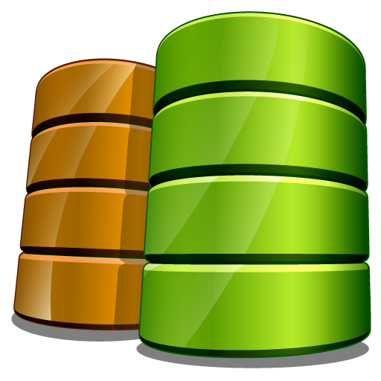
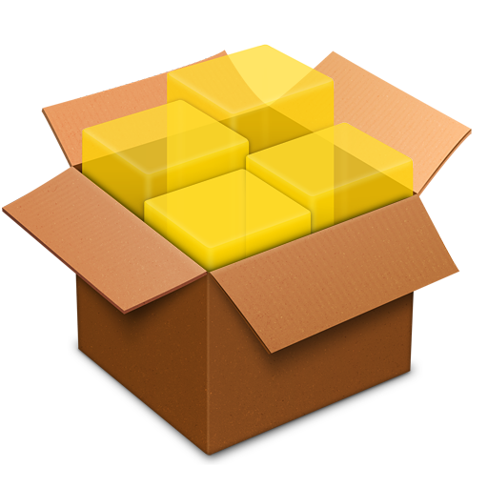
Cloud solution architecture
REFERENCE ARCHITECTURE
A draft architecture for “Your Events”
Here is a solution highlighting the key components of the application for a single organisation:
Your Events – App. Instance
Consume / Interact
3
Database
Events
Comments
RSVPs
Customer Org.
Management
Web App
Core Logic
Object Storage
Photos
Employees
1
Subscribe / Trial
Your Events - SaaS
2
Provision

Slide 24
Cloud solution architecture
REFERENCE ARCHITECTURE
A draft architecture for “Your Events”
We can observe a couple of things for the current design:
01
CLOUD NATIVE DESIGN
Because, there is no legacy, “Your Events” is conceived as a cloud native implementation. This means that each component / capability will be sourced / provisioned through the cloud platform.
02
MINIMUM VIABLE PRODUCT – KEY COMPONENTS
The design highlights the key components that make up the MVP: a web application accessible over the Internet, with two storage options a database for most of the data and an object store for photos.
03
PROVISIONING
The design shows an essential part of the solution, which is the ability to “provision on demand”, either because a new subscription or a trial request, an instance of the application for a customer.

Slide 25
Cloud solution architecture
REFERENCE ARCHITECTURE
Supporting multiple users
“Your Events” will generate profit Cloud Dynamics only if the solution depicted in the previous diagram can be repeated effortlessly and at minimal costs for Cloud Dynamics.
Observations:
01
MODERATE RETURN ON A SINGLE ORGANISATION (MVP)
“Your Events” is not an expensive service (at least the base one) and therefore Cloud Dynamics will benefit only by leveraging economies of scale and supporting multiple customer organisations.
02
EMERGING REQUIREMENTS
As a result, effective support of multiple groups of users is a key architectural concern, as much important as the single functions that define the MVP.

Slide 26
Cloud solution architecture
REFERENCE ARCHITECTURE
Storage considerations
Cloud Dynamics decided to use two different types of storage for persisting the application data:
01
DATABASE
For the particular type of application, both a relational and NoSQL solutions can be used to store information about events, users, and posts. Both solutions have their pros and cons. NoSQL and schema-less databases could facilitate the customisation, while relational databases bring the advantges of SQL.
02
OBJECT STORAGE
Object storage to storage for “objects”, these are meant to be addressed by a unique id and can support metadata. Object storage solutions are organised in “containers”, which are collection of objects.
Object storage is particularly suite to store any type of object (blob, document, etc.). Essentially, anything that can be stored in a file. In this scenario it is used to store event photos.

Slide 27
Questions

